Slide 1
Cloud Computing
Module 4
(Linux containers, Dockers and Orchestration tools)

Slide 2
Agenda
Linux Containers - LXC and LXD.
Cloud orchestration technologies
Dockers

Slide 3
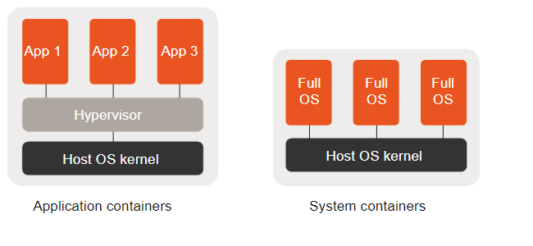
Difference Between Application Containers and System Containers

Slide 4
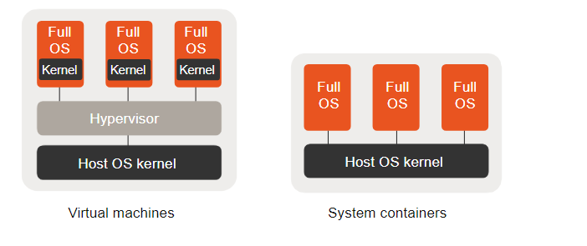
Difference Between System Containers and Virtual Machines

Slide 5
LXC (Linux Containers)
It is a system container.
It is a set of 1 or more processes that are isolated from the rest of the system.
It is used for Linux Containers which is an operating system that is used for running multiple Linux systems virtually on a controlled host via a single Linux kernel.
It lets Linux users easily create and manage system or application containers.
Features provided by LXC :
It provides Kernel namespaces such as IPC, mount, PID, network, and user.
Apparmor and SELinux profiles
Control groups (Cgroups).
Seccomp policies
Chroots (using pivot_root)
Goal: To create an environment as close as possible to a standard Linux installation but without the need for a separate kernel.

Slide 6
LXD (Linux container hypervisor)
LXD is a next generation system container manager. It offers a user experience similar to virtual machines but using Linux containers instead.
It is an extension of LXC with more functionality.
It provides flexibility and scalability for various use cases, with support for different storage backends and network types and the option to install on hardware ranging from an individual laptop or cloud instance to a full server rack.
It provides support for system containers and virtual machines.
Some Features of LXD are:
Secure by design (unprivileged containers, resource restrictions and much more)
Scalable (from containers on your laptop to thousand of compute nodes)
Intuitive (simple, clear API and crisp command line experience)
Image based (with a wide variety of Linux distributions published daily)
Support for Cross-host container and image transfer (including live migration)
Advanced resource control (cpu, memory, network I/O, block I/O, disk usage and kernel resources)
Device passthrough (USB, GPU, unix character and block devices, NICs, disks and paths)
Ref: https://linuxcontainers.org/lxd/introduction/
https://www.educba.com/lxc-vs-lxd/ (Differences between LXC and LXD)

Slide 7
Installation and Launching Containers
https://www.cyberciti.biz/faq/install-lxd-on-ubuntu-20-04-lts-using-apt/
lxc launch images:ubuntu/20.04 first
lxc info first
lxc stop first
lxc delete first
Lxc launch images:ubuntu/20.04 firstlimited –c limits.cpu=2 –limits.memory=200MiB
lxc execute firstlimited –bash
cat /etc/*release
push and pull

Slide 8
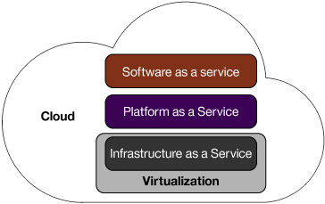
Virtualization and cloud computing
The manual approach to setting up environment included steps like these:
Wait for approval
Buy the hardware
Install the OS
Connect to and configure the network
Get an IP
Allocate the storage
Configure the security
Deploy the database
Connect to a back-end system
Deploy the application on the server
What challenges we face with the manual approach.?
Sol: backup, monitoring, networking, and configuring.

Slide 9
Significance of Configuration Management
The problem Context:
Suppose we have to deploy a software on top of hundreds of systems.
This software can be an operating system or a code or it can be an update of an existing software.
You can do this task manually, but what happens if you have to finish this task overnight because
tomorrow might be a Big Billion Day sale in the company or some Mega Sale etc. in which heavy traffic is
expected.
Even if you were able to do this manually there is a high possibility of multiple errors on your big day.
What if the software you updated on hundreds of systems is not working, then how will you revert back to the
previous stable version, will you be able to do this task manually.
To solve the above issues:
Configuration Management was introduced. Chef, Puppet, etc. are configuration management tools that can
automate the automate above tasks.
How it automates the above tasks?
We need to specify the configurations once on the central server and replicate that on thousands of nodes.

Slide 10
Configuration Management
It helps in performing the below tasks in a very structured and easy way:
Figuring out which components to change when requirements change.
Redoing an implementation because the requirements have changed since the
last implementation.
Reverting to a previous version of the component if you have replaced with a new but flawed version.
Replacing the wrong component because you couldn’t accurately determine
which component was supposed to be replaced.

Slide 11
Cloud Orchestration Technologies
Why Orchestration technologies are required?.
To quickly configure, provision, deploy, and
develop environments, integrate service management, monitoring, backup,
and security services. All these services are repeatable.
They are used to address key challenges IaaS providers face when building a cloud infrastructure: managing physical and virtual resources, namely servers, storage, and networks, in a holistic fashion.
The orchestration of resources must be performed in a way to rapidly and dynamically provision resources to Applications. The software toolkit responsible for this orchestration is called a virtual infrastructure manager (VIM).
It is also called as “cloud operating system” or “infrastructure sharing software” or “virtual infrastructure engine .”

Slide 12
Cloud Orchestration
What is Cloud orchestration?
It is the end-to-end automation of the deployment of services in a cloud environment.
-Manage cloud infrastructure: supplies and assigns required cloud resources to the customer like the creation of VMs, allocation of storage capacity, management of network resources, and granting access to cloud software.
Cloud Orchestration automates provisioning of multiple servers, storage, databases and networks to make deployment and management of processes and resources smoother.
It also ensures the complete maintenance of cloud elements in an integrated and harmonized way.
Objective: To accelerate the delivery of IT services while reducing costs.
Note:

Slide 13
Benefits of Cloud Orchestration
Effective Visibility and Control through dashboard
Cost-Effective
Reduced Errors

Slide 14
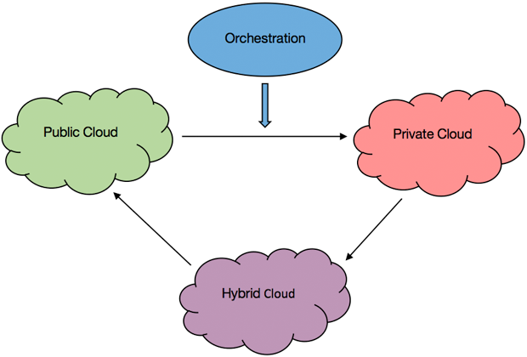
Three aspects of cloud orchestration:
Resource orchestration, where resources are allocated
Workload orchestration, where workloads are shared between the resources
Service orchestration, where services are deployed on servers or cloud environments
The orchestration automates the services in all types of clouds—public, private, and hybrid.

Slide 15
Difference between orchestration and automation
Automation usually focuses on a single task, while orchestration deals with the end-to-
end process, including management of all related services, taking care of high
availability (HA), post deployment, failure recovery, scaling, and more.
A single task is involved in cloud automation whereas in cloud orchestration It is concerned with combining multiple such tasks into workflows.
Some examples of cloud automation are Launching a web server, configuring a web
server and some cases of cloud orchestration are Combining automated tasks like launching
web server and configuring a web service into a single workflow to meet client requests
Note:
Note: Orchestrating is a process of automating a series of individual tasks to work together.

Slide 16
Orchestration tools
Cloud orchestration has useful tools that can automatically monitor cloud resources and
modify VM instances while reducing manual work and work hours and they ensure
efficient control on the cloud ecosystem.
Chef
Puppet
OpenStack (Already discussed)
Heat
Juju
Docker (Docker Swarm)

Slide 17
1. Chef
It is used in infrastructure automation and allow us to automate and control vast numbers of computers in an automated, reliable, and scalable manner.
Chef translates system administration tasks into reusable definitions, known as cookbooks and recipes.
Cookbooks are the configuration units that allow us to configure and perform specific tasks within Chef on our remote nodes
In a recipe, Chef authors define a system's desired state by writing configuration code. It specifies
which resources to use and the order in which they are to be used.
Chef then processes that code along with data about the specific node where the code is running to
ensure that the desired state actually matches the state of the system.
Chef uses a pure-Ruby, domain-specific language (DSL) for writing system configurations. It is
developed on the basis of Ruby DSL language. It is used to streamline the task of configuration
and managing the company’s server.
Notes:
Chef translates system administration tasks into reusable definitions, known as cookbooks and recipes. In a recipe, Chef authors define a system's desired state by writing configuration code. Chef then processes that code along with data about the specific node where the code is running to ensure that the desired state actually matches the state of the system.

Slide 18
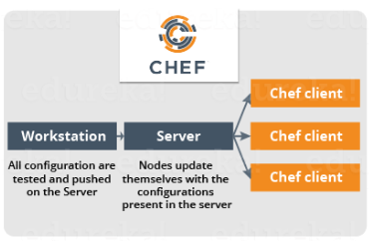
Chef Architecture
Functionality:
Chef allows us to dynamically provision and de-provision your infrastructure on demand to keep up with peaks in usage and traffic.
It enables new services and features to be
deployed and updated more frequently, with
little risk of downtime.
With Chef, we can take advantage of all the
flexibility and cost savings that cloud offers.
Note: The Chef client is an agent that runs on a node and performs the actual tasks that
configure it.
Chef can manage anything that can run the Chef client, like physical machines, virtual
machines, containers, or cloud-based instances.
Ref: https://www.edureka.co/blog/chef-tutorial/
Notes:
.

Slide 19
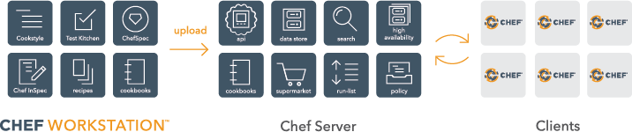
Chef Architecture Cont...

Slide 20
Chef Architecture Cont…
Pull Configuration: Nodes will automatically update themselves with the configurations present in the
Server.
Chef supports multiple platforms like AIX, RHEL/CentOS, FreeBSD, OS X,
Solaris, Microsoft Windows and Ubuntu.
Chef can be integrated with cloud-based platforms such as Amazon EC2,
Google Cloud Platform, OpenStack, SoftLayer, Microsoft Azure and Rackspace to
automatically provision and configure new machines.
Example demonstration of creating a chef book:
https://www.digitalocean.com/community/tutorials/how-to-create-simple-chef-cookbooks-to-manage-infrastructure-on-ubuntu

Slide 21
Chef cookbooks
Chef uses cookbooks to determine how each node should be configured.
Cookbooks are usually used to handle one specific service, application, or functionality. For instance, a cookbook can be created to set and sync the node’s time with a specific server. It may install and
configure a database application. Cookbooks are basically packages for infrastructure choices.
Cookbooks consist of multiple recipes; a recipe is an automation script for a particular service that’s written using the Ruby language.
Cookbooks are created on the workstation and then uploaded to a Chef server.
From there, recipes and policies described within the cookbook can be assigned to nodes as part of the
node’s “run-list”.
A run-list is a sequential list of recipes and roles that are run on a node by chef-client in order to bring the
node into compliance with the policy you set for it.
Note1: https://www.linode.com/docs/guides/beginners-guide-chef/ and https://docs.chef.io/chef_overview/
Note2: https://www.digitalocean.com/community/tutorials/how-to-create-simple-chef-cookbooks-to-manage-infrastructure-on-ubuntu

Slide 22
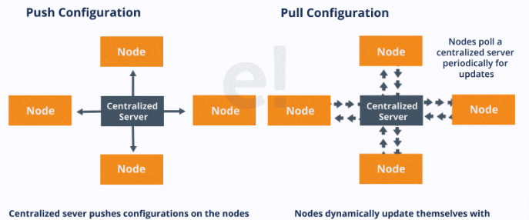
There are broadly two ways to manage your configurations namely Push and Pull configurations.
Pull Configuration: In this type of Configuration Management, the nodes poll a centralized server
periodically for updates. These nodes are dynamically configured so basically they are pulling configurations
from the centralized server.
Pull configuration is used by tools like Chef, Puppet etc.
Push Configuration: In this type of Configuration Management, the centralized Server pushes the
configurations to the nodes. Unlike Pull Configuration, there are certain commands that have to be executed in the centralized server in order to configure the nodes.
Push configuration is used by tools like Ansible and Salt Stack
Ref: https://www.edureka.co/blog/what-is-chef/

Slide 23
2. Puppet
What is Puppet?
Puppet is a Configuration Management tool and can be used to install and manage software on existing
server instances (e.g., installation of packages, starting of services, installing scripts or config files on the instance).
Puppet is also used as a software deployment tool. It is an open-source configuration management software
widely used for server configuration, management, deployment, and orchestration of various applications and
services across the whole infrastructure of an organization.
Puppet is specially designed to manage the configuration of Linux and Windows systems.
It is written in Ruby and uses its unique Domain Specific Language (DSL) to describe system configuration.
They do the heavy lifting of making one or many instances perform their roles without the user needing to
specify the exact commands. No more manual configuration or ad-hoc scripts are needed.

Slide 24
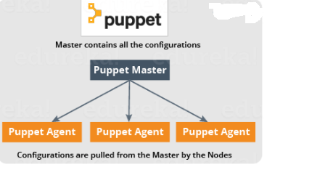
Puppet (Cont…)
It requires installation of a master server and client agent in target nodes, and includes an option for a
standalone client.

Slide 25
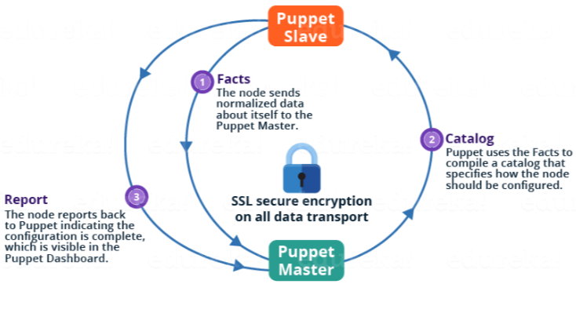
Puppet
https://www.edureka.co/blog/puppet-tutorial/

Slide 26
Puppet Versions
Puppet comes in two versions:
Open Source Puppet: It is a basic version of Puppet configuration management tool, which is also known as Open Source Puppet. It is available directly from Puppet's website and is licensed under the Apache 2.0 system.
Puppet Enterprise: Commercial version that offers features like compliance reporting, orchestration, role-based access control, GUI,API and command line tools for effective management of nodes.

Slide 27
Puppet Functionalities
Defining distinct configurations for each and every host, and continuously checking and confirming whether the required configuration is in place or not.
Dynamic scaling-up and scaling-down of machines.
Providing control over all your configured machines, so a centralized (master-server) change gets propagated to all, automatically.

Slide 28
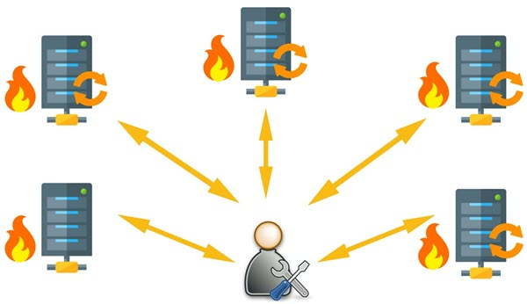
What Puppet Can do?.
Note: The role of system admin is to ensure that all these servers are always up to date and running with full
functionality.

Slide 29
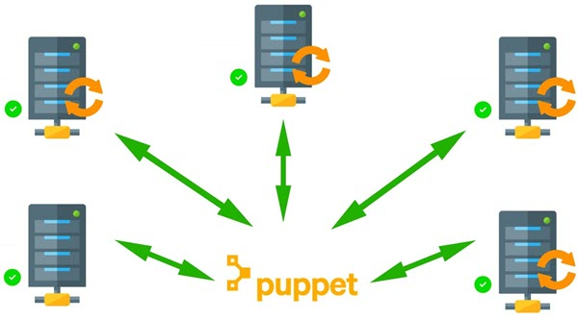
What Puppet Can do?. (Cont…)
Note: Puppet here allows you to write a simple code which can be deployed automatically on these servers. This reduces the human effort and makes the development process fast and effective.

Slide 30
How Puppet Works?
Puppet is based on a Pull deployment model, where the agent nodes check in regularly after every 1800 seconds with the master node to see if anything needs to be updated in the agent.
If anything needs to be updated the agent pulls the necessary puppet codes from the master and performs required actions.
Example: Master - Agent Setup:
The Master:
A Linux based machine with Puppet master software installed on it. It is responsible for maintaining configurations in the form of puppet codes. The master node can only be Linux.
The Agents:
The target machines managed by a puppet with the puppet agent software installed on them.

Slide 31
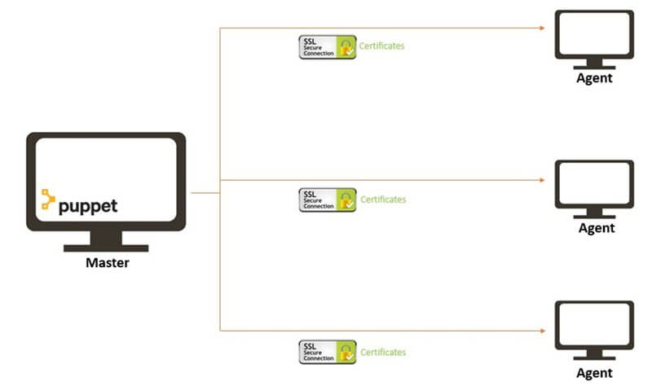
How Puppet Works? (Cont…)
The agent can be configured on any supported operating system such as Linux or Windows or Solaris or Mac OS.
The communication between master and agent is established through secure certificates.
1. Connection Establishment

Slide 32
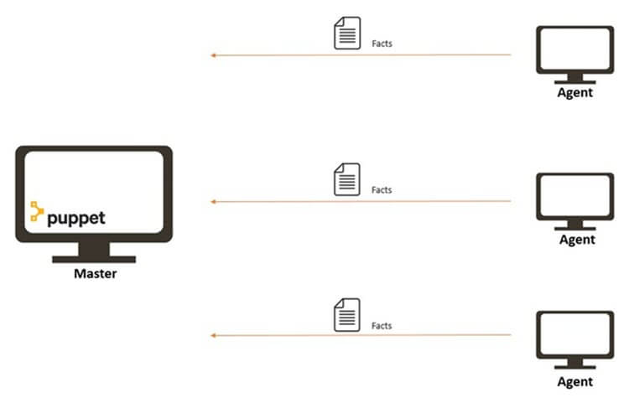
How Puppet Works? (Cont…)
2. Agents send Facts
to the Master
Facts contain information that includes the hostname, kernel details, IP address, file name details, etc.

Slide 33
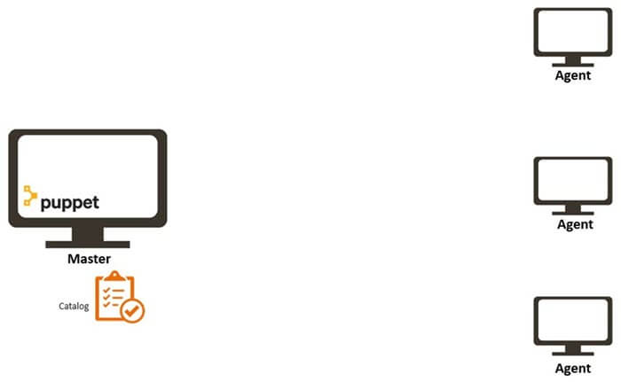
How Puppet Works? (Cont…)
3. Master sends catalog to Agent
Master sends catalog to Agent
Puppet Master uses Facts’ data and compiles a list with the configuration to be applied to the
agent. This list of configuration to be performed on an agent is known as a catalog (package installation, upgrades or removals, File System creation, user creation or deletion, server reboot, IP configuration changes, etc.).

Slide 34
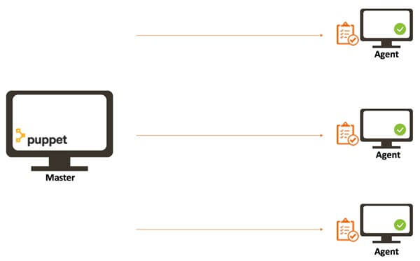
How Puppet Works? (Cont…)
4. Each Agents applies
configuration
Note: Once the node apply configuration, then the node reports back to puppet master indicating that the
configuration has been applied and completed.

Slide 35
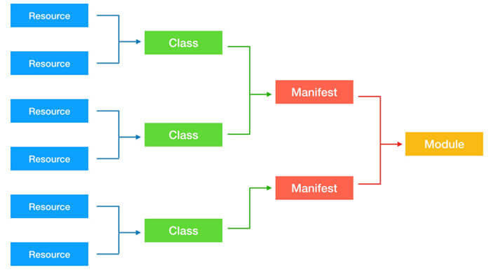
Puppet Blocks

Slide 36
Puppet Blocks (Cont…)
Puppet Resources:
Puppet Resources are the building blocks of Puppet.
Resources are the inbuilt functions that run at the back end to perform the required operations in puppet.
Puppet Classes:
A combination of different resources can be grouped together into a single unit called class.
Puppet Manifest:
Manifest is a directory containing puppet DSL files. Those files have a .pp extension. The .pp extension stands for puppet program. The puppet code consists of definitions or declarations of Puppet Classes.
Puppet Modules:
Modules are a collection of files and directories such as Manifests, Class definitions. They are the re-usable and sharable units in Puppet.
Ref:https://www.guru99.com/puppet-tutorial.html and https://www.guru99.com/devops-tutorial.html

Slide 37
Differences between Puppet and Chef
How the two platforms (Puppet and Chef) stack up against one another:
Puppet is geared toward system admins who need to specify configurations like dependencies, whereas Chef is for developers who actually write the code for the deployment.

Slide 38
Differences between Puppet and Chef (Cont…)
While both tools have similar goals, the means used to achieve them differ. Some of them are provided below:
2. How resources are described:
Puppet uses a declarative language that is similar to JSON or XML.
You describe the resource’s state but cannot intervene in how this state is achieved.
Chef uses an imperative language. This means you more or less have full-featured Ruby at your disposal.
For example, Puppet is like writing configuration files whereas using Chef is like programming the control of your nodes.
If you or your team have more experience with system administration, you may prefer Puppet. On the other
hand, if most of you are developers, Chef might be a better fit.

Slide 39
Differences between Puppet and Chef (Cont…)
2. Configuration files:
In Puppet, you create manifests and modules, while in Chef you deal with recipes and cookbooks.
Manifests and recipes usually describe single resources while modules and cookbooks describe the more
general concepts (a LAMP server running your application, for instance).
Examples of resources with which one can deal with are files, directories, network interfaces, and applications. Commands like mkdir, cat, and apt-get or yum are replaced with desired states (“present,” “absent,” “updated,” and so on).

Slide 40
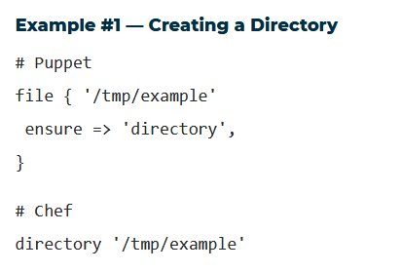
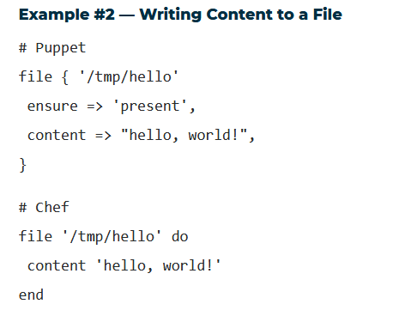
Differences between Puppet and Chef (Cont…)
Examples of resource definitions for a directory and a file

Slide 41
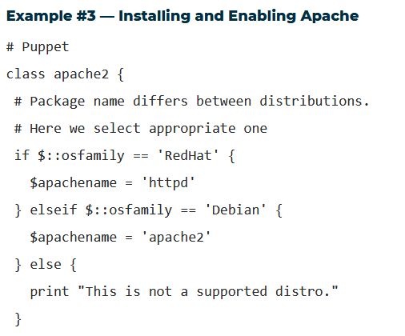
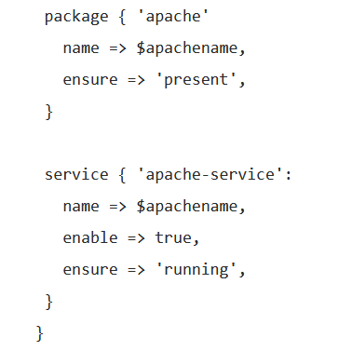
Differences between Puppet and Chef (Cont…)

Slide 42
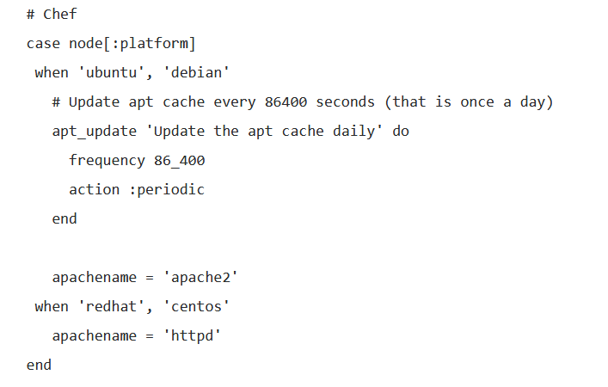
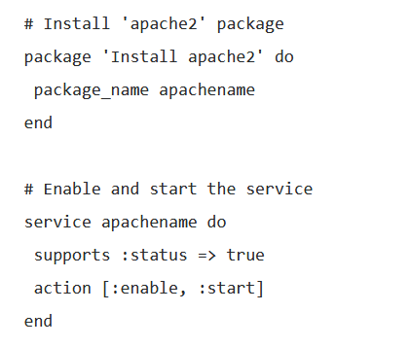
Differences between Puppet and Chef (Cont…)
Examples of resource definitions for a installing and Enabling Apache using Chef

Slide 43
3. OpenStack
Note: It is already discussed and please refer to
module 3 slides that was shared with you on CMS

Slide 44
4. Heat
Heat is the main project in the OpenStack Orchestration program.
Heat allows developers to store the requirements of a cloud
application in a file that defines what resources are necessary for that
application.
In many ways, Heat does for applications what OpenStack
infrastructure components (Nova, Cinder, and the like) do for vendor
hardware and software—it simplifies the integration.

Slide 45
4. Heat (Cont...)
It enables orchestration engine to launch multiple composite cloud applications based on templates in the form of text files that can be treated like code.
A native Heat template format is evolving, but Heat also endeavours to provide compatibility with the AWS CloudFormation template format, so that many existing CloudFormation templates can be launched on OpenStack.
heat-engine:
The heat engine does the main work of orchestrating the launch of templates and providing events back to the API consumer.

Slide 46
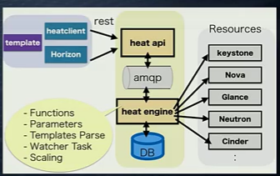
How heat works?

Slide 47
How heat works? (Cont….)
Heat manages the whole lifecycle of the application - when you need to change your infrastructure, simply
modify the template and use it to update your existing stack.
A Heat template describes the infrastructure for a cloud application in a text file that is readable and writable by
humans, and can be checked into version control, diffed, etc.
Infrastructure resources that can be described include: servers, floating ips, volumes, security groups, users, etc.
Heat knows how to make the necessary changes. It will delete all of the resources when you are finished with the application, too.
Heat primarily manages infrastructure, but the templates integrate well with software configuration management tools such as Puppet and Chef.
Heat also provides an autoscaling service that integrates with Telemetry, so you can include a scaling group as a
resource in a template.
Templates can also specify the relationships between resources (e.g. this volume is connected to this server).
This enables Heat to call out to the OpenStack APIs to create all of your infrastructure in the correct order to completely launch your application.

Slide 48
Heat Orchestration Templates (HOT)
(HOT) are native to Heat and are expressed in YAML. These templates consist of:
Resources (mandatory fields) are the OpenStack objects that you need to create, like server, volume, object storage, and network resources. These fields are required in HOT templates.
Parameters (optional) denote the properties of the resources. Declaring the parameters can be more convenient that hard coding the values.
Output (optional) denotes the output created after running the Heat template, such as the IP address of the server.
Each resource, in turn, consists of:
References—used to create nested stacks
Properties—input values for the resource
Attributes—output values for the resource

Slide 49
Basic HOT template
#template structure
heap_template_version:2015-04-30
#validate version of HOT
description:
# Template description (features available or functions)
parameters:
#Template input parameters (Security groups, which one to use, which SSH key to use, etc.)
resources:
#Resources to be created (e.g., virtual machines).
outputs:
#The output (IP address to login the created VM)

Slide 50
Creating and deploying a Heat Template
A template which will create the following and connect them up:
A network
A static IP
A router
An instance
A floating IP
A volume
The Heat template: The template must be in yaml format and be saved with the .yaml file
extension.
Note: We should also make sure that you use the correct indentation.
Steps for deploying:
Define a Heat template’s required parameters in a YAML file, and
Deploy the template via the command line (OpenStack CLI).

Slide 51
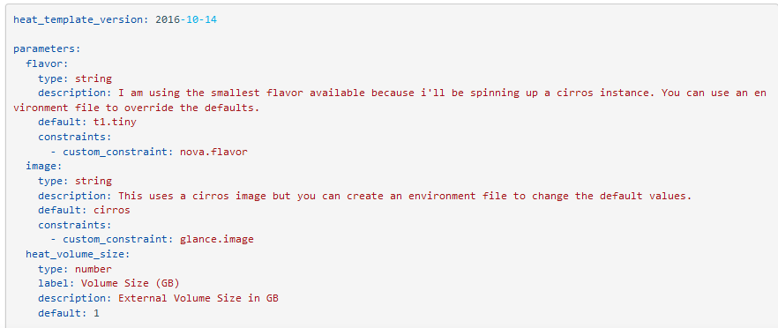
basic-stack.yaml
(Note: A Stack means a group of connected cloud resources)

Slide 52
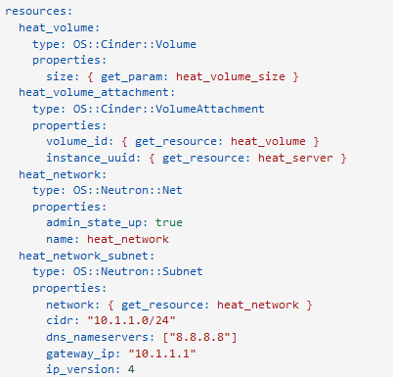
basic-stack.yaml (cont….)

Slide 53
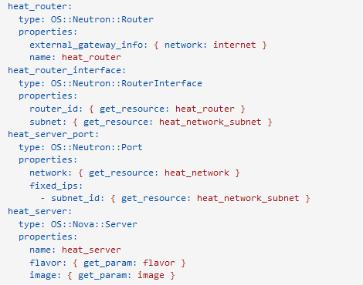
basic-stack.yaml (cont….)

Slide 54
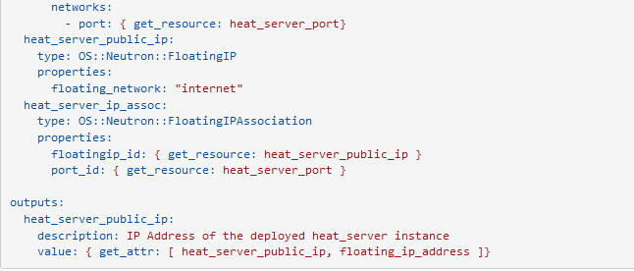
basic-stack.yaml (cont….)

Slide 55

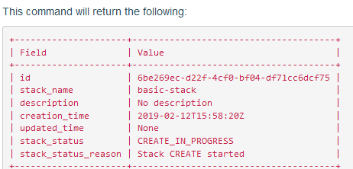
Deploying the stack
Create a stack by running the following command in the OpenStack CLI:
openstack stack create -t <template name> <stack name>

Slide 56
References of Heat
https://docs.ukcloud.com/articles/openstack/ostack-how-create-heat-template.html
https://clouddocs.f5.com/cloud/openstack/v1/heat/how-to-deploy-heat-stack.html
Ref:https://wiki.openstack.org/wiki/Heat
https://developer.ibm.com/articles/cl-cloud-orchestration-technologies-trs/
https://livebook.manning.com/book/openstack-in-action/chapter-12/11

Slide 57
5. Juju
What is Juju?
Juju is a state-of-the-art, open source modelling tool for operating software in the cloud.
Juju allows us to deploy, configure, manage, maintain, and scale cloud applications quickly and efficiently on public clouds as well as physical servers, OpenStack, and containers.
We can use Juju from the command line or through its beautiful GUI.
The goal of Juju is to reuse of common operational code in widely different environments.
It is an open source automatic service orchestration management tool developed by Canonical, the developers of the Ubuntu OS.

Slide 58
Application modelling?
In modern environments, Even simple applications may require several other applications in order to function - like a database and a web server.
For modeling a more complex system, e.g. OpenStack, many more applications need to be installed, configured
and connected to each other.
Juju’s application modelling provides tools to express the intent of how to deploy such applications and to subsequently scale and manage them.
With Juju, you create a model of the relationships between applications that make up our solution and we have a
mapping of the parts of that model to machines. Juju then applies the necessary configuration management scripts to each machine in the model.
Application-specific knowledge such as dependencies, scale-out practices, operational events like backups and
updates, and integration options with other pieces of software are encapsulated in Juju’s ‘charms’.

Slide 59
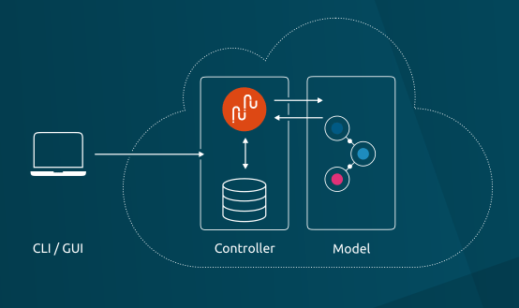
How Juju works?
Juju controller: the heart of Juju
Juju's controller manages all the machines in our running models, responding to the events that are triggered throughout the system.
It also manages scale out, configuration and placement of all your models and applications.

Slide 60
Terminologies of Juju
Charms
Charms are sets of scripts for deploying and operating software. With event handling built in, they can declare interfaces that fit charms for other services, so relationships can be formed.
Bundles
Bundles are collections of charms that link services together, so you can deploy whole chunks of app infrastructure in one go.
What they do:
Install
Configure
Connect
Upgrade and update
Scale out and scale back
Perform health checks
Undertake operational actions

Slide 61
charms
Juju utilizes charms, which are open source tools that simplify specific deployment and management tasks.
The charm defines everything you all collaboratively know about deploying that particular application brilliantly
Charms encapsulate application configurations, define how services are deployed, how they connect to other services, and how they are scaled. Also define how services integrate, and how their service units react to events in the distributed environment, as orchestrated by Juju.
After a service is deployed, Juju can define relationships between services and expose some services to the outside world.
Notes:
A Juju charm usually includes all of the intelligence needed to scale a service horizontally by adding machines to the cluster, preserving relationships with all of the services that depend on that service.
Juju provides both a command-line interface and an intuitive web application for designing, building, configuring, deploying, and managing your infrastructure. Juju automates the mundane tasks, allowing you to focus on creating amazing applications.
Charm store includes a collection of charms that let you deploy whatever services you like in Juju.
Ref: https://developer.ibm.com/articles/cl-cloud-orchestration-technologies-trs/

Slide 62
Charms (Cont…)
What language are charms written in?
Charms can be written in any language or configuration management scripting system. Chef and Puppet are common, more complex charms tend to use Python.
Charms have been written in Ruby, PHP, and many charms are a collection of simple bash scripts.
What charms are currently available?
Charms are available for hundreds of common and popular cloud-oriented applications such as MySQL, MongoDB, and others, with new ones being added every day. Check out the public charm store for an up to the minute list of charms: Juju Charm Store

Slide 63
Application scenario with Charms and Bundles
Modern applications are typically composed of many applications - databases, front-ends, big data stores, logging systems, key value stores.
Each application will be defined by a single charm.
To describe the whole application you need to describe the set of charms and their relationships - what is connected to what - and we use a bundle for that.

Slide 64
Example Application with Juju (Charms and Bundles)
A content-management system bundle could specify a database and a content management server,
together with key-value stores and front-end load-balancing systems.
Each of those applications are described by a charm; the bundle describes the set of charms, their
configuration, and the relationships between them.
This allows development teams to share not only the core primitive for each application, but also
enables sharing higher-level models of several applications.
It allows you to replicate complex application models in a cloud just by dropping the same bundle onto your Juju GUI.
Bundles can be shared publicly or privately.
New bundles are added to the public collection every week. And you can now bootstrap Juju, launch
the GUI and deploy a bundle with a single command. That means you can go from zero to a full cloud deployment in seconds with the right bundle.

Slide 65
Benefits of Juju
Juju is the fastest way to model and deploy applications or solutions on all major public clouds and containers.
It helps to reduce deployment time from days to minutes.
Juju works with existing configuration management tools, and can scale workloads up or down very easily.
No prior knowledge of the application stack is needed to deploy a Juju charm for the product.
Juju includes providers for all major public clouds, such as Amazon Web Services, Azure, and HP as well as OpenStack, MAAS, and LXC containers.
It also offers a quick and easy environment for testing deployments on a local machine. Users can deploy entire cloud environments in seconds using bundles, which can save a lot of time and effort.
References of Juje:
https://developer.ibm.com/articles/cl-cloud-orchestration-technologies-trs/
https://juju.is/docs/writing-your-first-juju-charm
https://www.youtube.com/watch?v=Lt9-a6pDxsA

Slide 66

Dockers
It is an open-source project that automates the deployment of applications inside software containers.
All applications have their own dependencies, which include both software and hardware resources.
Docker is a mechanism that helps in isolating the dependencies per each application by packing them into containers.
It provides tools for simplifying DevOps by enabling developers to create templates called images that can be used to create lightweight virtual machines called containers, which include their applications and all of their applications’ dependencies.

Slide 67
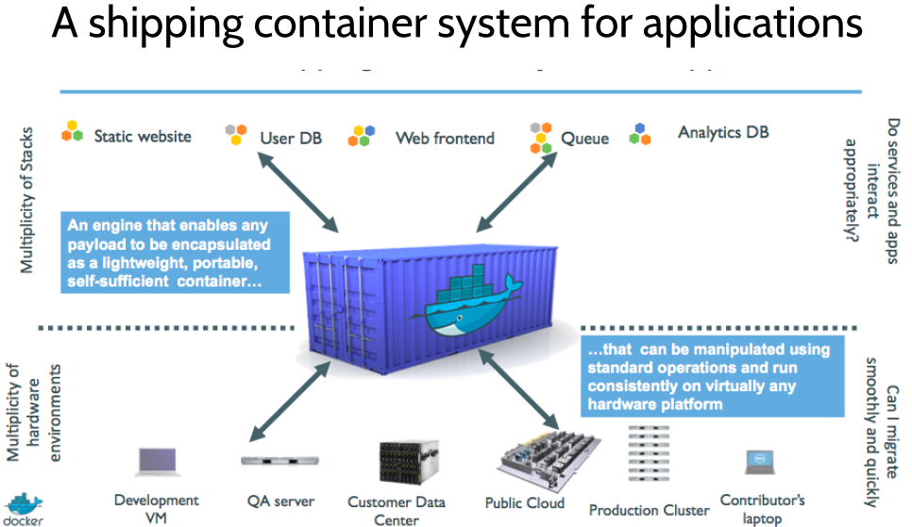

Slide 68
What benefits the Docker (Container) provide?
Docker enables developers to easily pack, ship, and run any application as a lightweight, portable, self-sufficient container, which can run virtually anywhere. Containers do this by enabling developers to isolate code into a single container. This makes it easier to modify and update the program.
Containerization is an approach of running applications on an OS such that the application is isolated from the rest of the system.
Main features of Docker are Develop, ship and run anywhere.
They aim at facilitating developers to easily develop applications, ship them along with their dependencies into containers which can then be deployed anywhere. It is aimed to address portability issue.
Note: The whole idea of Docker is for developers to easily develop applications, ship them into containers which can then be deployed anywhere.
Ref: http://www.ce.uniroma2.it/courses/sdcc1819/slides/Docker.pdf and Also, refer to module 2 slides for more information about Dockers.

Slide 69
Container orchestration (e.g., Docker Swarm)
Container Orchestration
It is the automatic process of managing or scheduling the work of individual containers for applications based on microservices within multiple clusters.
Examples of container orchestration platforms are based on open-source versions like Kubernetes, Docker Swarm or the commercial version from Red Hat OpenShift.
Docker container orchestration tool, also known as Docker Swarm, can package and run applications as containers, find existing container images from others, and deploy a container on a laptop, server or cloud (public cloud or private).
Reference: https://avinetworks.com/glossary/container-orchestration/

Slide 70
Why Do We Need Container Orchestration?
Container orchestration is used to automate the following tasks at scale: • Configuring and scheduling of containers • Provisioning and deployments of containers • Availability of containers • The configuration of applications in terms of the containers that they run in • Scaling of containers to equally balance application workloads across infrastructure • Allocation of resources between containers • Load balancing, traffic routing and service discovery of containers • Health monitoring of containers • Securing the interactions between containers.

Slide 71
How Does Container Orchestration Work?
Configurations files tell the container orchestration tool how to network between containers and where to store
logs.
The orchestration tool also schedules deployment of containers into clusters and determines the best host for the container. After a host is decided, the orchestration tool manages the lifecycle of the container based on predetermined specifications. Container orchestration tools work in any environment that runs containers.
Orchestration tools for Docker include the following: • Docker Machine — Provisions hosts and installs Docker Engine. • Docker Swarm — Clusters multiple Docker hosts under a single host. It can also integrate with any tool that
works with a single Docker host. • Docker Compose — Deploys multi-container applications by creating the required containers.

Slide 72
Benefits of Containerized Orchestration Tools
Increased portability — Scale applications with a single command and only scale specific functions without affecting the entire application. • Simple and fast deployment — Quickly create new containerized applications to address growing traffic. • Enhanced productivity — Simplified installation process and decreased dependency errors. • Improved security — Share specific resources without risking internal or external security.
Application isolation improves web application security by separating each application’s process into different containers.
Note: Refer to the slides of Module 2 for more information about the Docker files and their creation.

Slide 73
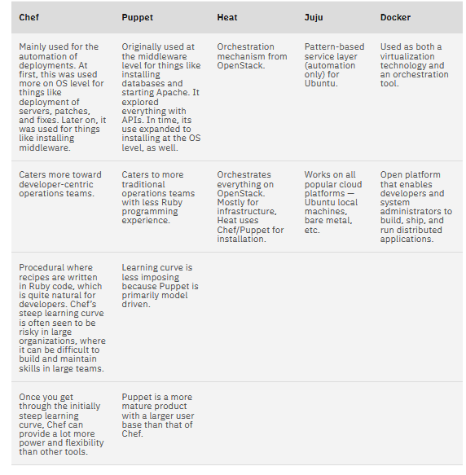
Comparison of cloud Orchestration tools

